Slide 1
Introduction to ASP.NET & Visual Studio Web Tools
[Speaker]
[Company]
Email: [Email]
Twitter: [Twitter]
Notes:
Description
We'll start out by explaining the One ASP.NET experience in Visual Studio 2013, showing how to create hybrid web applications. Next, we'll introduce new features for web developers in Visual Studio 2013 and Web Essentials, explaining how Visual Studio is the best editor for HTML, CSS and JavaScript as well as your back end code. We'll also look at some new features across the ASP.NET platform including new Bootstrap templates, the new scaffolding system, and the new membership and identity system.

Slide 2
Today’s Agenda
Session | Start | End
Keynote | 8:30 | 9:00
Introduction to ASP.NET and Visual Studio 2015 Web Tools | 9:00 | 10:45
Break | 10:45 | 11:00
Building Web Applications using the latest ASP.NET technologies | 11:00 | 12:15
Lunch | 12:15 | 1:15
Building web front ends for both desktop and mobile using the latest web standards | 1:15 | 2:15
API Services for both web and devices | 2:15 | 3:15
Break | 3:15 | 3:30
Running, improving and maintaining a site in the real world | 3:30 | 4:30
Wrap Up | 4:30 | 5:00

Slide 3
Agenda
Release Recap
ASP.NET Updates
Visual Studio + Web Essentials
ASP.NET 5

Slide 4
ASP.NET and Web Tools Cadence
Rapid releases | Continuous Updates | Match the Speed of Web Dev
Visual Studio 2013 + ASP.NET 4.5.1
Visual Studio 2013.1
Visual Studio 2013.2
Visual Studio 2013.3
Visual Studio 2013.4
Visual Studio 2013.5
2013
Oct
2014
Apr
Jul
Oct
2015
Apr
Jul
Oct
2015
Visual Studio 2015 + ASP.NET 4.6

Slide 5

New ASP.NET Core Features

Slide 6
ASP.NET Updates
Top Features in ASP.NET 4.5 and up
One ASP.NET
Bootstrap Templates
.NET Compiler Plarform (“Roslyn”)
ASP.NET 5
OWIN
HTTP/2 Support
ASP.NET Identity
Web Form Model Binding

Slide 7
One ASP.NET
Released with Visual Studio 2013
Sites
Services
Web
Forms
Web
Pages
Single
Page
Apps
MVC
Web
API
SignalR
ASP.NET

Slide 8
One ASP.NET
Sites
Services
YOU!
Web
Forms
Web
Pages
Single
Page
Apps
MVC
Web
API
SignalR
YOU!
ASP.NET

Slide 9
One ASP.NET
Sites
Services
YOU!
Web
Forms
Web
Pages
Single
Page
Apps
MVC
Web
API
SignalR
YOU!
ASP.NET

Slide 10
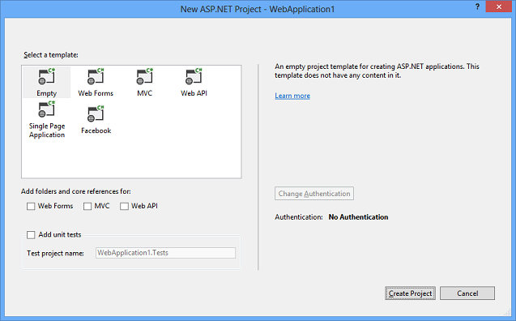
One ASP.NET
Visual Studio 2013 – New ASP.NET Project
Notes:
Visual Studio 2013 and ASP.NET 4.5 merged the different project types, so you really could create an ASP.NET project with Web Forms, MVC and Web API easily.

Slide 11
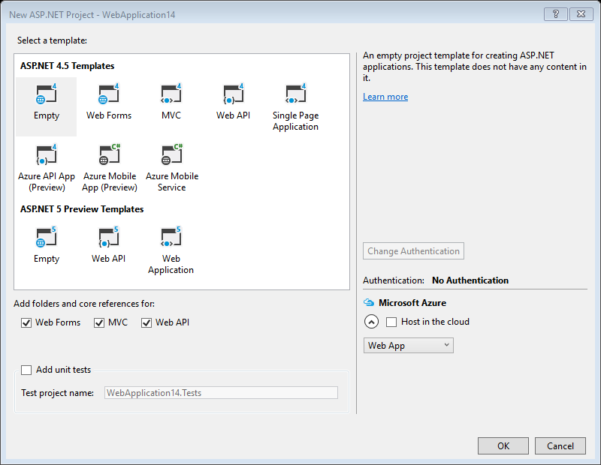
ASP.NET 5: New, but still one project type
Visual Studio 2015 – New ASP.NET Project
Notes:
Okay, in a way, we’re sort of back to two ASP.NETs with Visual Studio 2015. ASP.NET 5 introduces some breaking changes and doesn’t support Web Forms, so a separate template type.
However, the momentum of One ASP.NET has continued with ASP.NET 5. Because MVC and Web API have merged in ASP.NET 5, there are fewer project types in the ASP.NET Preview Templates.

Slide 12



ASP.NET 2015 in a Nutshell
Visual Basic 14
Visual Basic 14 (coming soon)
C#
Web
Forms
MVC 5.x
Web API 2.2
MVC / Web API 6
ASP.NET 4.6 System.Web
ASP.NET 5
Core CLR
.Net Native
.NET Framework 4.6
.NET Core 5
Full .NET Framework for any scenario and
library support on Windows
Modular libraries & runtime optimized for server and cloud workloads

Slide 13
MVC + Web API + Web Pages = ASP.NET MVC 6

Slide 14
MVC 6: MVC, Web API, Web Pages
One set of concepts – remove duplication
Web UI and Web APIs
Smooth transition from Web Pages to MVC (future)
Built DI first
Built on ASP.NET 5
Runs on IIS or self-hosted
Supports .NET Core

Slide 15


ASP.NET 5 – Key Values
Totally Modular
Faster Development Cycle
Seamless transition from on-premises to cloud
Choose your Editors
and Tools
Open Source with Contributions
OSS
Cross-Platform
Fast

Slide 16
Demo
Getting started with ASP.NET 5 & ASP.NET MVC 6
Notes:
DEMO-One-ASP-NET
## Overview ## In this demo you will walk through the process of creating a new site using the new One ASP.NET tooling in Visual Sudio. You will start with a Web Forms application, create a simple model "Person" and use the new tooling to scaffold an MVC and a Web Api controller for it.
### Goals ###
In this demo, you will see how to:
1. Create a new ASP.NET 4.5 site using the Web Forms template, checking the Web Forms, MVC and Web API checkboxes
2. Create a simple model "Person" 3. Scaffold an MVC controller for Person
4. Scaffold a Web API controller for Person

Slide 17
TagHelpers
HTML helpers expressed as tags
Ex. Instead of:
@Html.LabelFor(m => m.UserName, new { @class = "col-md-2 control-label" })
Write this:
<label asp-for="UserName" class="col-md-2 control-label"></label>
Easier to customize with additional attributes
Work seamlessly with the HTML editor

Slide 18
TagHelpers
@using (Html.BeginForm(new { ReturnUrl = ViewBag.ReturnUrl })) {
@Html.AntiForgeryToken()
@Html.ValidationSummary(true)
<fieldset>
<legend>Log in Form</legend>
<ol>
<li>
@Html.LabelFor(m => m.UserName)
@Html.TextBoxFor(m => m.UserName)
@Html.ValidationMessageFor(m => m.UserName)
</li>

Slide 19
TagHelpers
<form anti-forgery=“true“ validation-summary=“true” action="Create“>
<fieldset>
<legend>Log in Form</legend>
<ol>
<li>
<label for=“UserName”>
<input for=“UserName”>
<span validation-for="Name" style="color:blue" />
</li>

Slide 20
TagHelpers: Create Your Own
public interface ITagHelper
{
int Order { get; }
Task ProcessAsync(TagHelperContext context, TagHelperOutput output);
}
Examples: https://github.com/aspnet/Mvc/tree/dev/src/Microsoft.AspNet.Mvc.TagHelpers

Slide 21
Demo
Tag Helpers

Slide 22
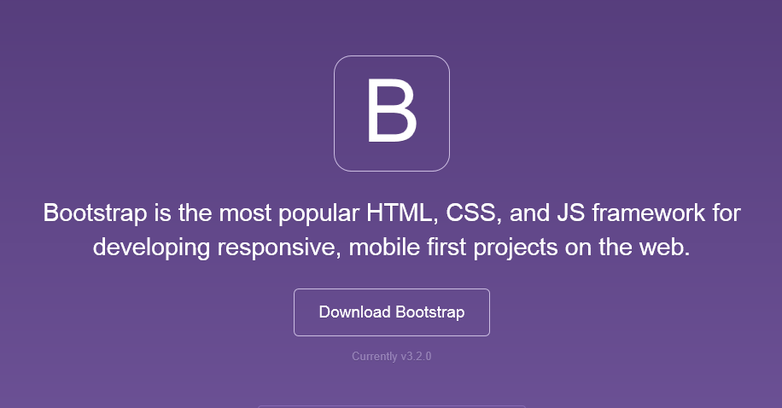
Bootstrap
We’ll talk more about Bootstrap later on…
The most popular front-end framework for developing responsive, mobile first projects on the web.

Slide 23
ASP.NET Identity
The ASP.NET Identity system is designed to replace the previous ASP.NET Membership and Simple Membership systems. It includes profile support, OAuth integration, works with OWIN, and is included with the ASP.NET templates shipped with Visual Studio 2013.
The ASP.NET Identity system from ASP.NET 4.x forms the basis for the ASP.NET Identity system used in ASP.NET 5.

Slide 24
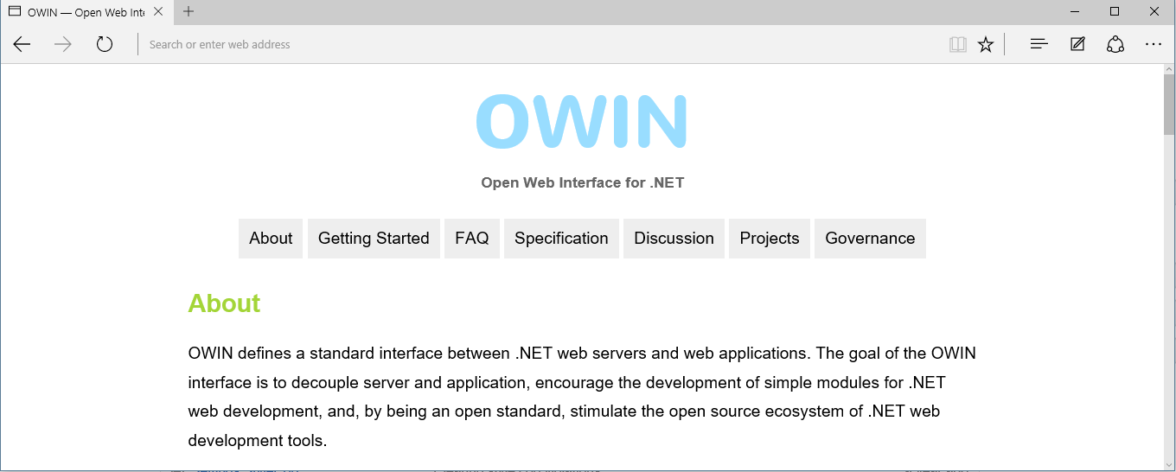
OWIN (Open Web Interface for .NET)
OWIN in an open, community owned specification
OWIN defines pluggable middleware and hosting
ASP.NET 4.5 and ASP.NET 5 both support OWIN
Notes:
This slide introduces these features at a high level. The demo for these features is included in the next section.

Slide 25
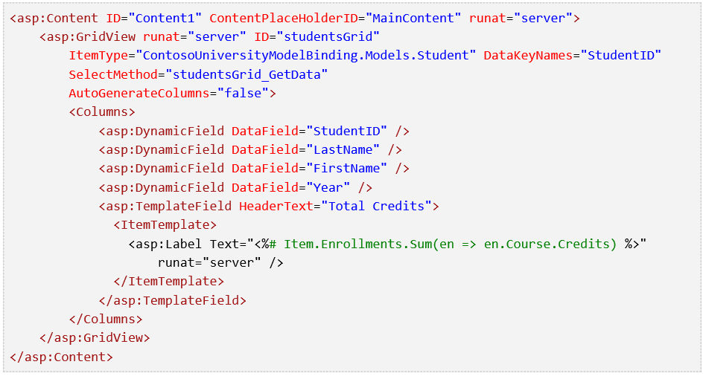
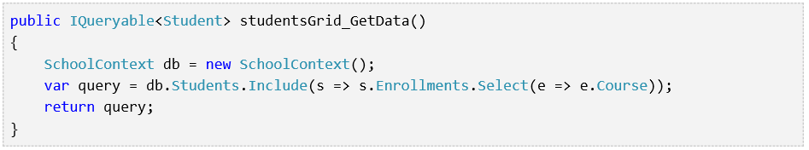
Web Forms Model Binding
Better separation of concerns
Share models with ASP.NET MVC, Web API
ASP.NET 4.6 adds Async support
Notes:
http://www.asp.net/web-forms/overview/presenting-and-managing-data/model-binding/retrieving-data

Slide 26
HTTP/2 Support
Binary transmission instead of text
Fully multiplexed instead of ordered and blocking
One connection to the server - parallel loading of resources
Header compression is now used to reduce overhead
Servers can now “push” responses proactively into client caches
Notes:
https://channel9.msdn.com/Events/Visual-Studio/Connect-event-2014/812?ocid=player

Slide 27
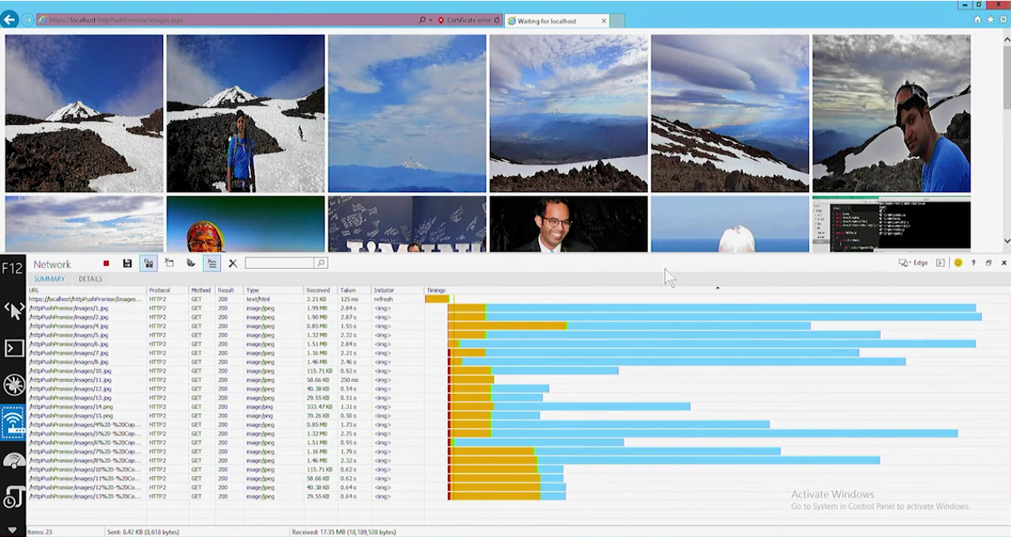
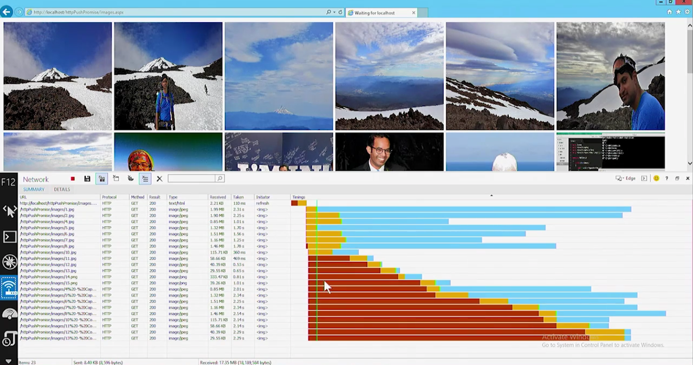
HTTP/2 Support
Binary transmission instead of text
Fully multiplexed instead of ordered and blocking
One connection to the server - parallel loading of resources
Header compression is now used to reduce overhead
Servers can now “push” responses proactively into client caches
Notes:
https://channel9.msdn.com/Events/Visual-Studio/Connect-event-2014/812?ocid=player

Slide 28
.NET Compiler Platform (“Roslyn”)
Support for new language features
Improved App startup / Pre-compile time
ASP.NET Web Forms 4.6 includes Roslyn via NuGet by default.

Slide 29
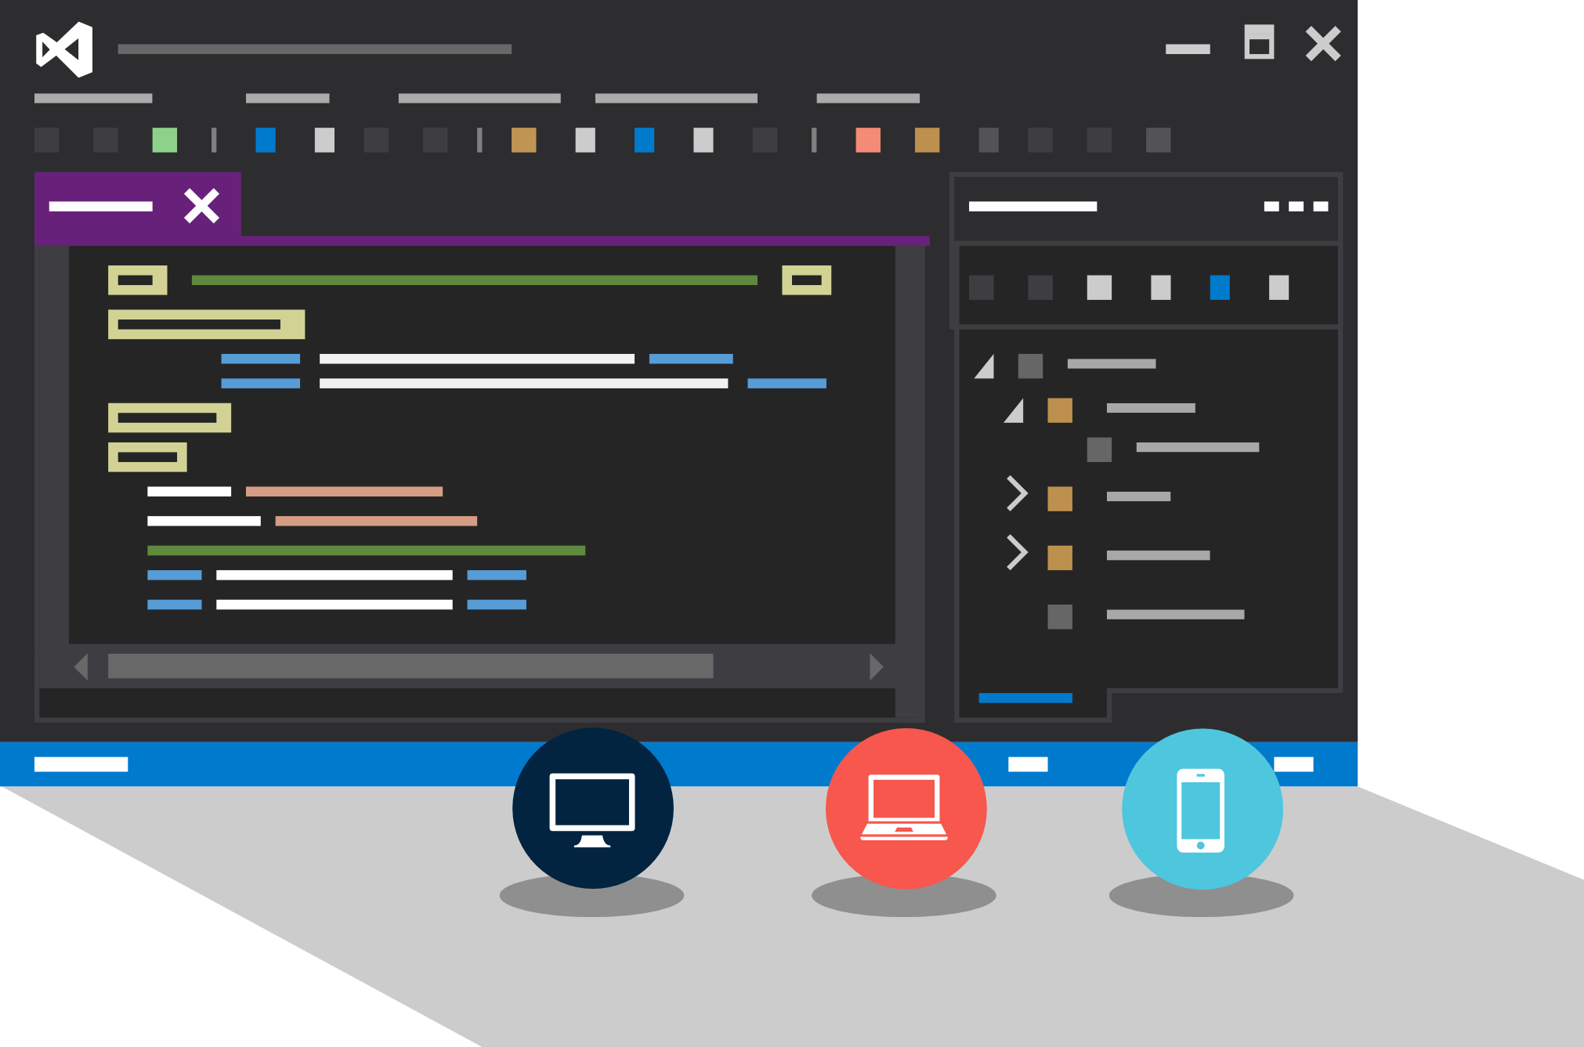
Visual Studio Web Tools

Slide 30
Visual Studio 2015
Top Features for Web Developers
NPM Integration
JSON Editor
Browser Link
Web Essentials
HTML Editor
JavaScript Editor

Slide 31
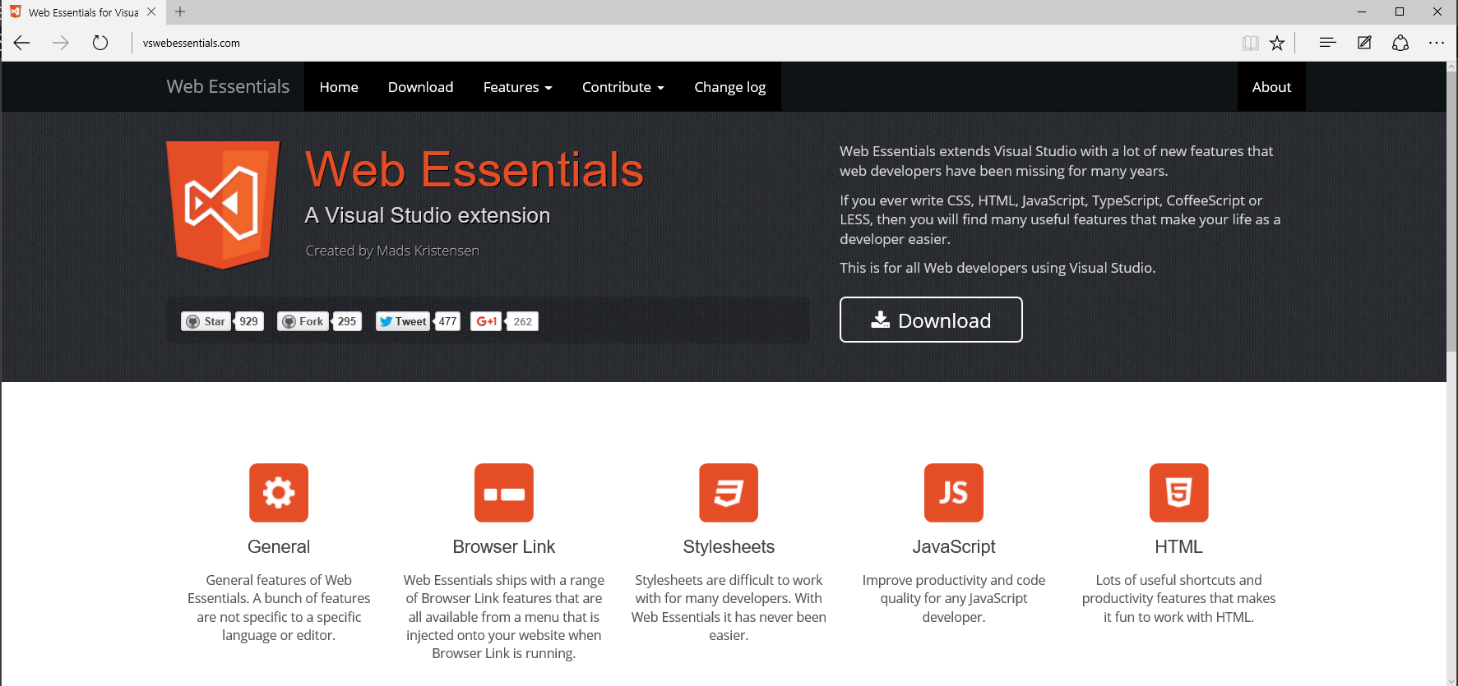
VS Web Essentials

Slide 32
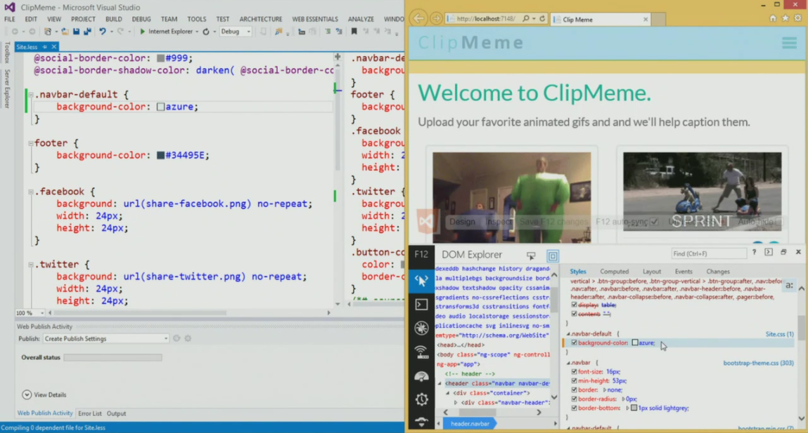
BrowserLink

Slide 33
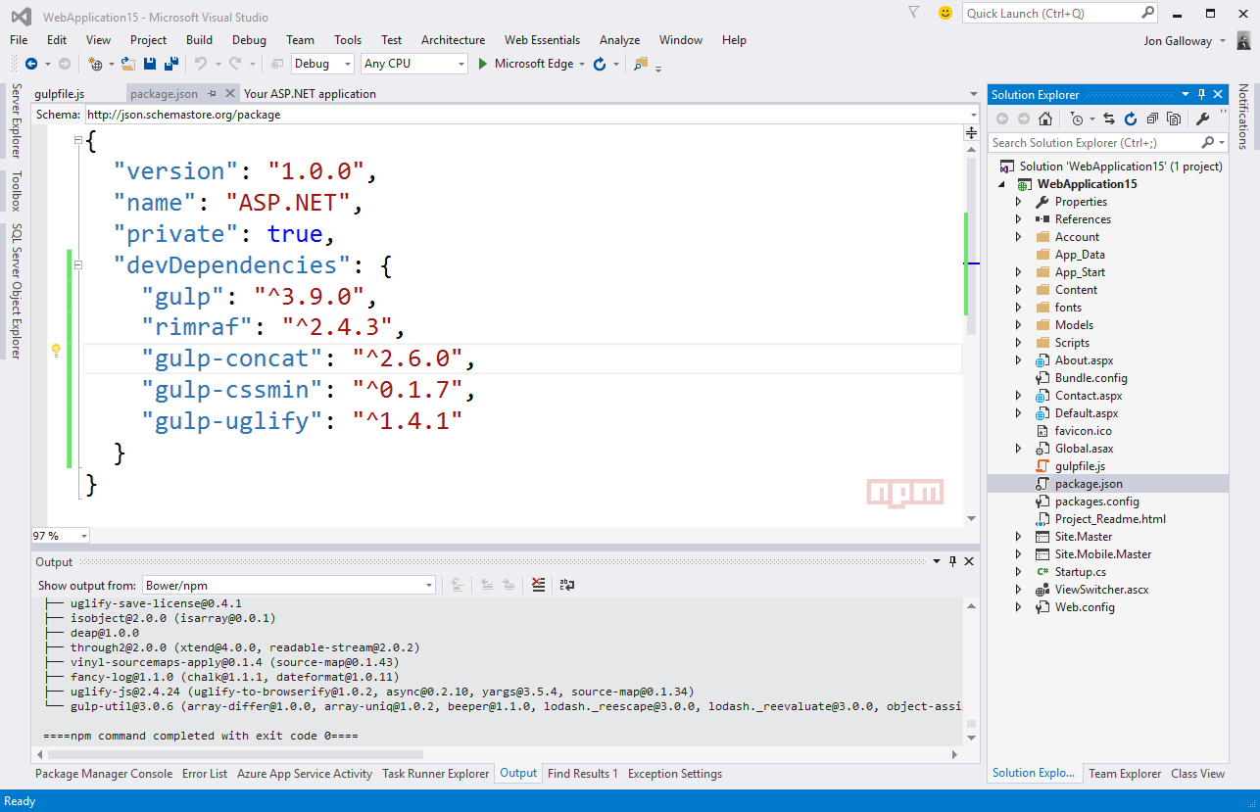
NPM Integration

Slide 34
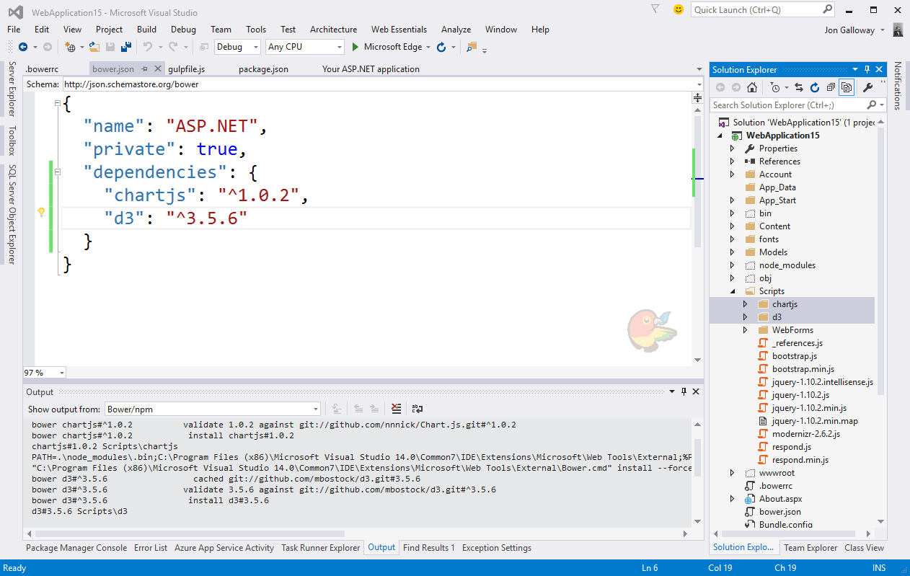
NPM ecosystem - Bower

Slide 35
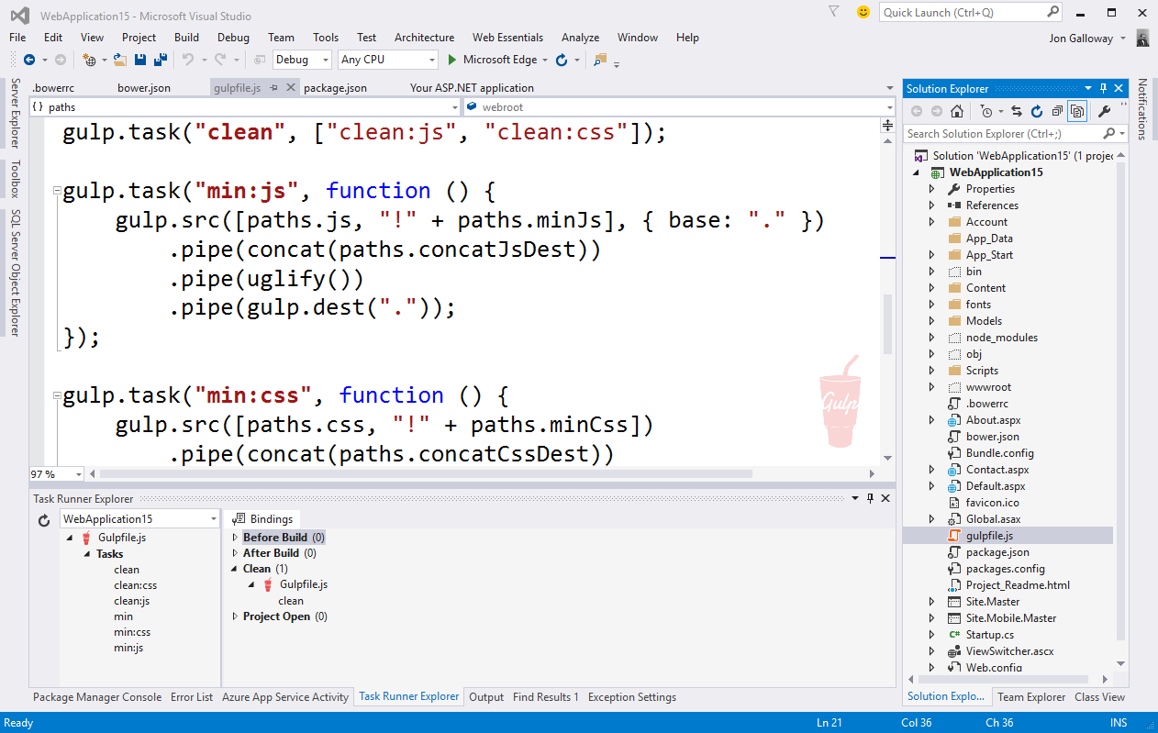
NPM ecosystem – Grunt / Gulp

Slide 36
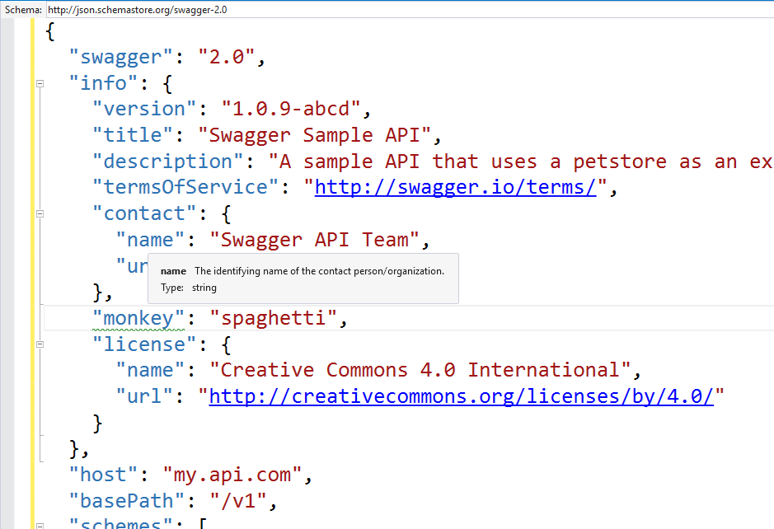
JSON Editor
Auto-completion
Tooltips
Supports SchemaStore.org
Powers NPM, Bower editing
Notes:
http://schemastore.org/json/

Slide 37
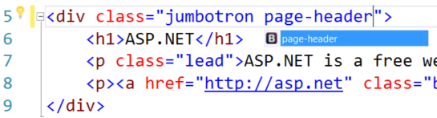
HTML Editor
Angular directives and attributes
Bootstrap class IntelliSense
Web Components and custom elements
Notes:
http://blogs.msdn.com/b/webdev/archive/2015/07/20/announcing-asp-net-4-6-and-asp-net-5-beta-5-in-visual-studio-2015-release.aspx

Slide 38
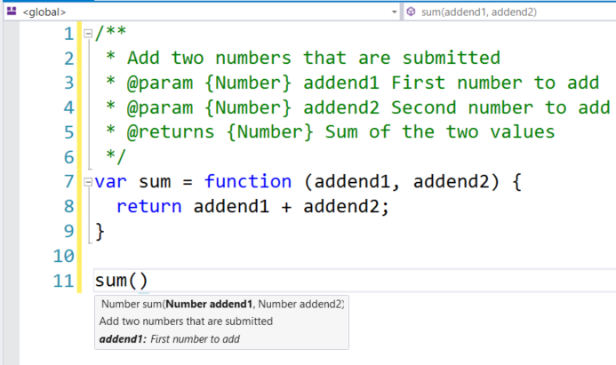
JavaScript Editor
AngularJS Support
ES6 features
Classes
Arrow Functions
Template Strings
JSDoc IntelliSense
JSX (React.js)
Notes:
http://blogs.msdn.com/b/webdev/archive/2015/07/20/announcing-asp-net-4-6-and-asp-net-5-beta-5-in-visual-studio-2015-release.aspx

Slide 39
Demo
Visual Studio Web Tools

